Slide 1
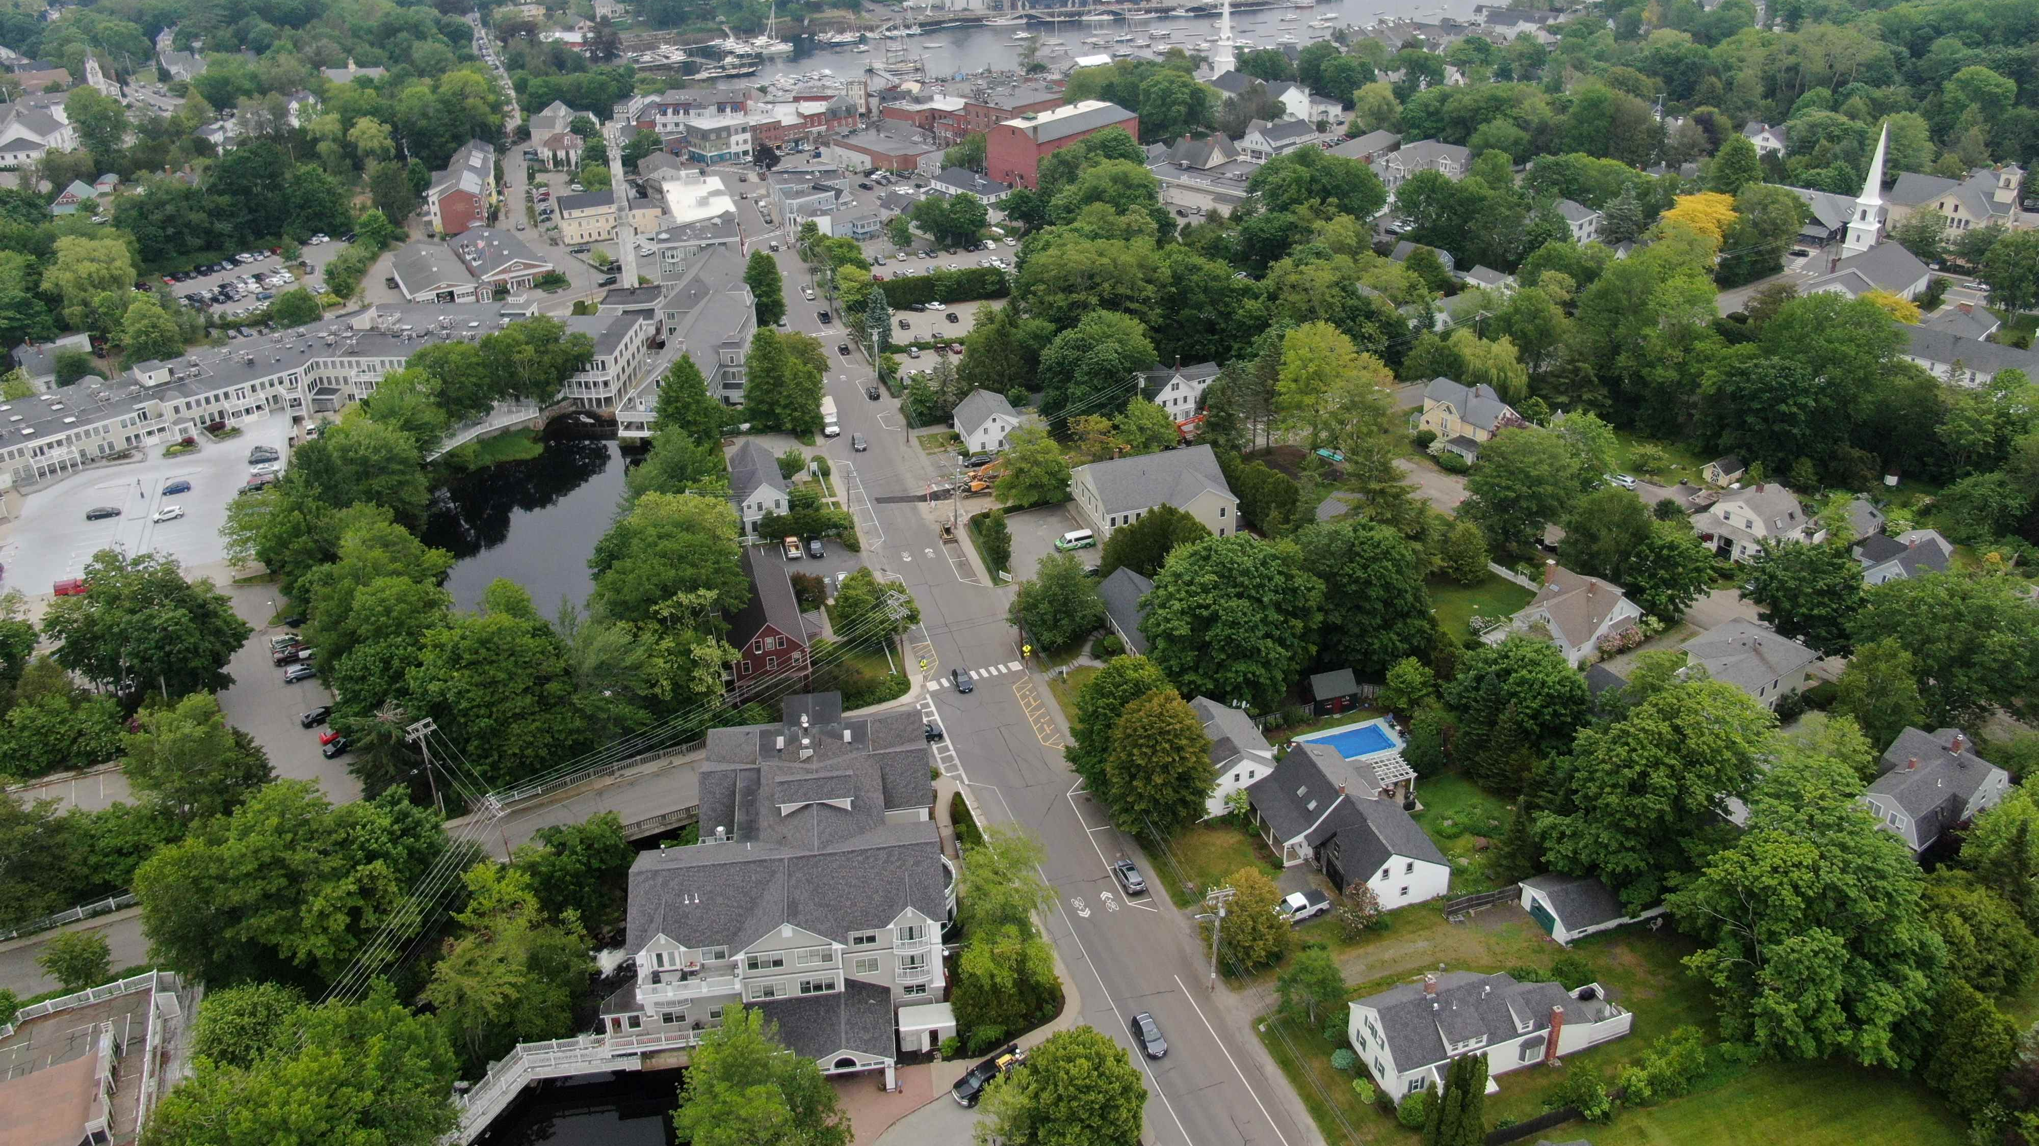
Climate Change & Wastewater/Stormwater Infrastructure

Slide 3
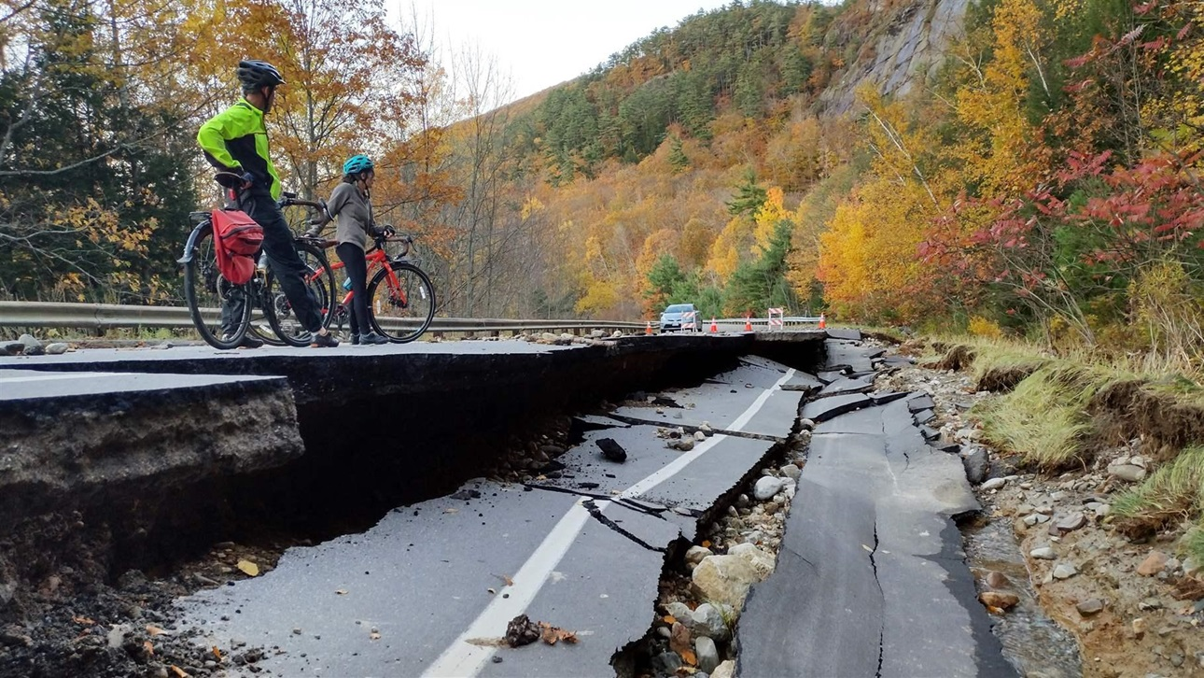
The frequency of extreme precipitation events in Maine increased 74% between 1948 and 2011.
Intense storms that used to occur an average of once per 12 months now happen once per 7 months.
The maximum hourly rate of precipitation increased by about 35% between 2001 and 2013.
The frequency and intensity of extreme precipitation events are expected to continue increasing in the coming decades.
The University of Maine Climate and Agriculture Network

Slide 4
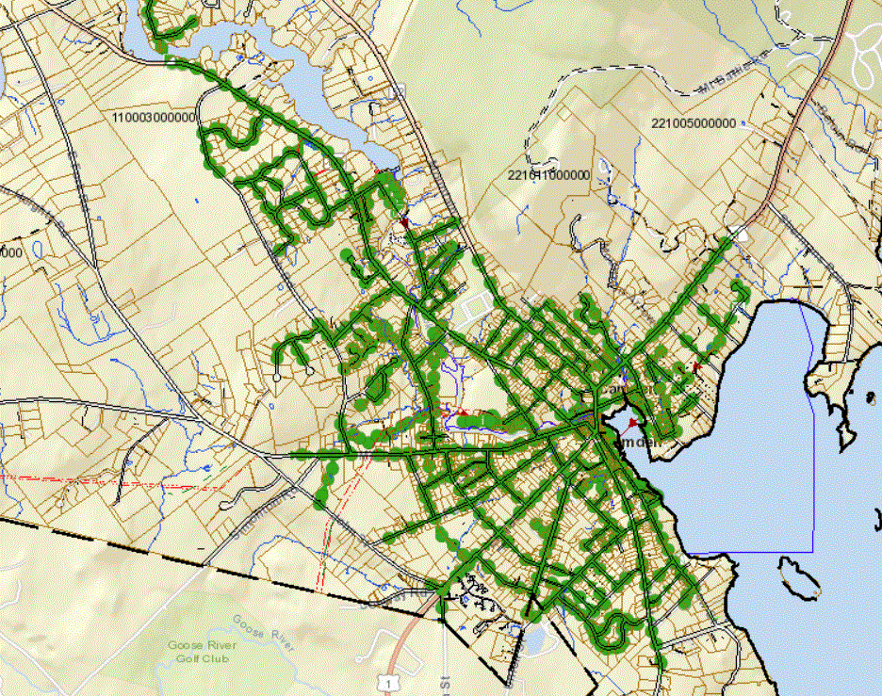
Camden’s Wastewater Collection System

Slide 6
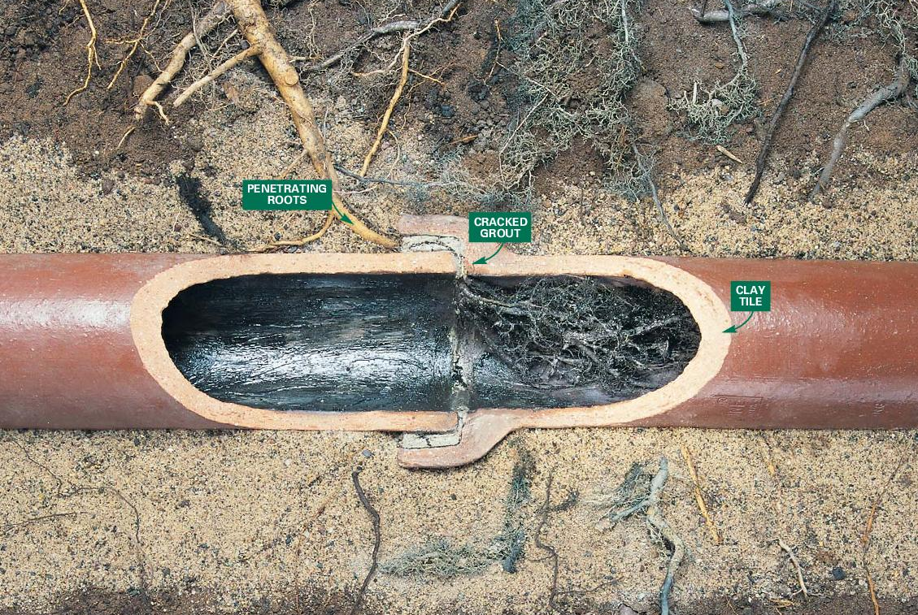
Sewer Mains: Early 1900’s Clay Tile Pipe

Slide 7
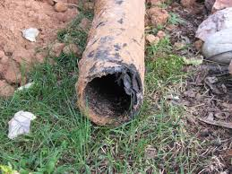
Sewer Laterals: Orangeburg
Wood pulp sealed with liquified coal tar pitch

Slide 8
Sanitary Sewer Overflow

Slide 9
Sewer Backups in Homes

Slide 10
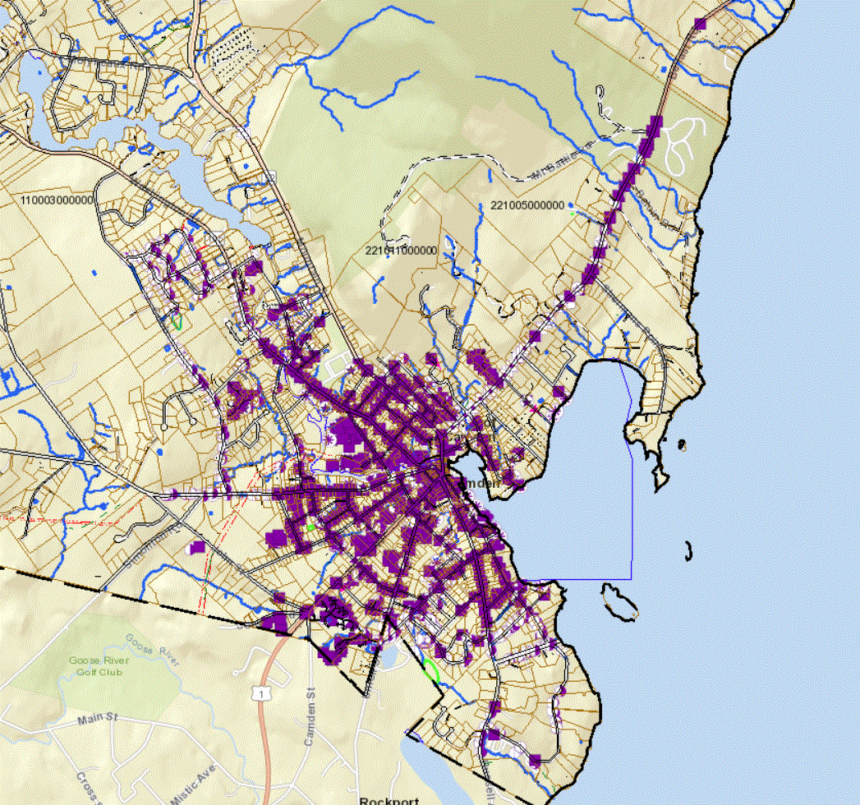
Camden’s Stormwater Collection System

Slide 12
Capacity Issues

